Slide 1
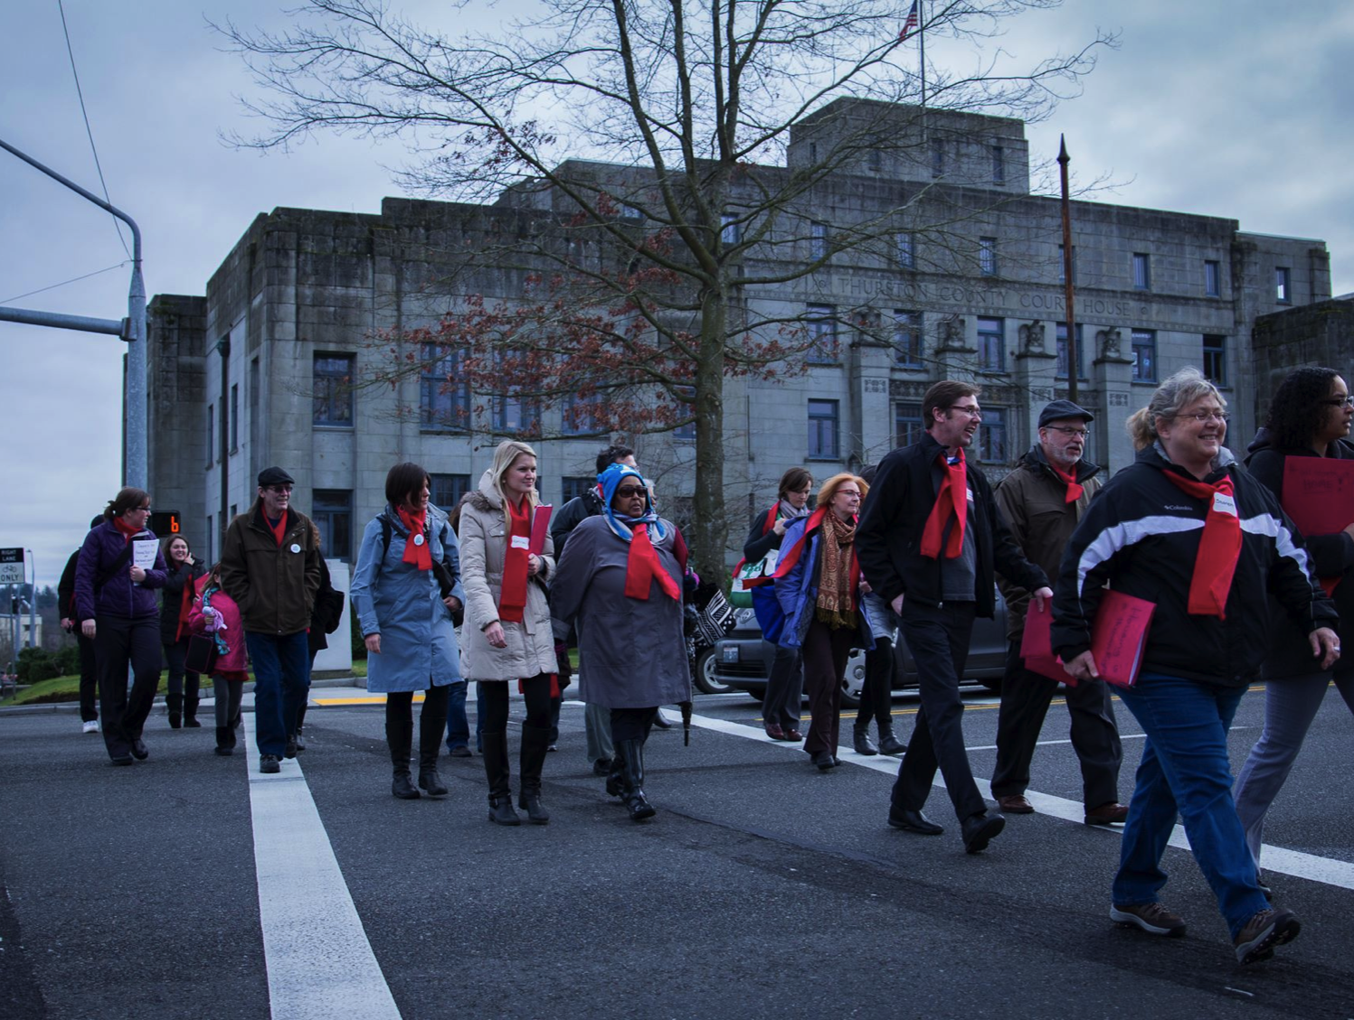
The Washington Low Income
Housing Alliance
Everyone should have the opportunity to live in a safe, healthy and affordable home.

Slide 2
Help inform the Housing Alliance
2019 Legislative Agenda
Thank you for joining us today!
Today’s agenda:
Introductions
Housing Alliance Agenda Setting Process
Overview of 2018 legislative outcomes & look ahead to 2019
Group discussion on 2019 state legislative priorities
In-district advocacy and Housing Alliance resources

Slide 3
2019 agenda setting process and timeline
Now – July: Input from stakeholders statewide
July – August: Housing Alliance Public Policy committee fine-tunes and sends proposal to board
September: Housing Alliance board votes
Now – December: Housing Alliance & advocates educate lawmakers
January: 2019 Legislative session starts

Slide 4
2018 Legislative Outcomes for
Affordable Housing & Homelessness
Biennial Capital Budget with $107 Million for the Housing Trust Fund = passed
HB 1570/Macri = passed
HB 2578/Riccelli = passed
HB 2667/Macri = passed
HB 2444/Slatter = passed
HB 2382/Ryu = passed
HB 1239/Sullivan = passed
HB 1831/Pettigrew = passed
HB 2437/Robinson = not passed (made it to Senate Floor)

Slide 5
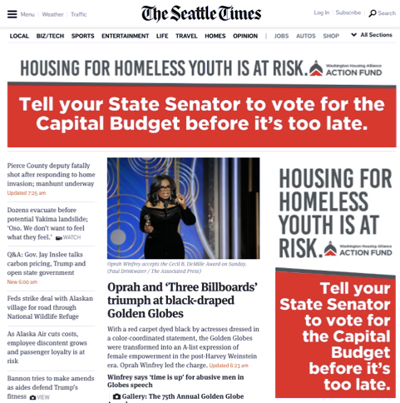

Slide 7
HB 2578/Riccelli:
Outlaws discrimination with very broad definition of “source of income” and creates a new Landlord Mitigation Program.
If source of income requires inspection of the property and repairs exceed $1,500, landlord doesn’t have to accept the tenant unless they access the mitigation fund to help pay for the repair cost.
If a landlord requires a threshold level of income, any source of income in the form of a rent voucher or subsidy must be subtracted from the total of the monthly rent prior to calculating if the income criteria have been met.
Landlords in violation of this act are subject to up to four and half times the monthly rent, court costs and reasonable attorney fees.

Slide 8
HB 2578: Definition of “source of income”
Source of income includes benefits or subsidy programs including housing assistance, public assistance, emergency rental assistance, veterans benefits, social security, supplemental security income or other retirement programs, and other programs administered by any federal, state, local, or nonprofit entity. "Source of income" does not include income derived in an illegal manner.

Slide 9
HB 2667:
Allows people with permanent disabilities and who qualify for the Aged, Blind & Disabled cash program (up to $197) to receive rental assistance from Housing & Essential Needs.
Included an emergency clause to immediately save the housing of people being transferred to the ABD program because their disability status changed from temporary to permanent.
Removes exemption for people with a primary disability of a substance use disorder from Housing & Essential Needs.
Improves data sharing between state departments (DSHS and Commerce) to ensure that county-based HEN providers can conduct outreach to people who may qualify for HEN rental assistance.

Slide 10
How a bill becomes law
Legislation is written and “introduced”.
It is assigned a committee and needs a hearing before cutoff.
It goes through other committees and makes it to the “floor” for a full vote before cutoff.
It goes over to the other chamber and repeats the process.
If passed by both chambers, it goes to the governor for signature or veto.

Slide 11
Factors poised to impact 2019
Significant election coming up in November 2018 - All members of the House of Representatives are up - Half of the Senate is up - The current balance of power is thinly held by Democrats with a margin of one vote in each chamber
Capital Budget anticipated to be constrained by school construction.
Operating Budget already has a lot of big-ticket demands on it.

Slide 12
Advocacy will be critical!

Slide 13
We want to hear from you
What were/are the biggest barriers to getting into or keeping an affordable home?

Slide 14
We want to hear from you
What are the biggest barriers to housing that people in your community are facing?
If a lawmaker sat down and listened to your story, what is the most important thing you’d want them to learn?

Slide 15
We want to hear from you
Of the following, which are the two most important priorities?
Increasing funding for affordable housing.
Addressing racial equity be making it illegal to deny tenancy solely because of a prior criminal record.
Increasing and protecting funding for homeless services and safety net programs
Removing barriers to housing and improving tenant protections
Increasing funding for behavioral health care and chemical dependency services.
Increase state revenue and transform the state’s regressive tax structure.
Prohibit local jurisdictions from criminalizing homelessness.

Slide 16
We want to hear from you
Who is willing to commit to meeting with your lawmakers this interim?

Slide 17
We want to hear from you
Who is willing to commit to meeting with your lawmakers this interim?
The Housing Alliance has programs and resources to engage advocates!

Slide 18
In-district advocacy and lawmaker education will be critical. The Housing Alliance is a resource for engagement:
Resident Action Project
Legislative District Leads
Lifting up Stories of Success Campaign
Voter Engagement

Slide 19
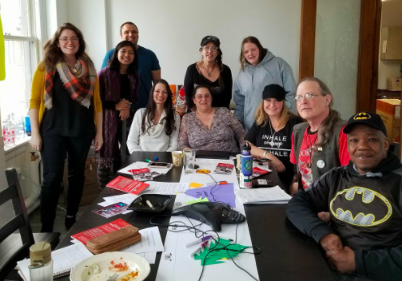
RAP is a statewide network led by people who have experienced housing injustice. Together, we're building power to change state policy through storytelling, organizing, and civic action.

Slide 20
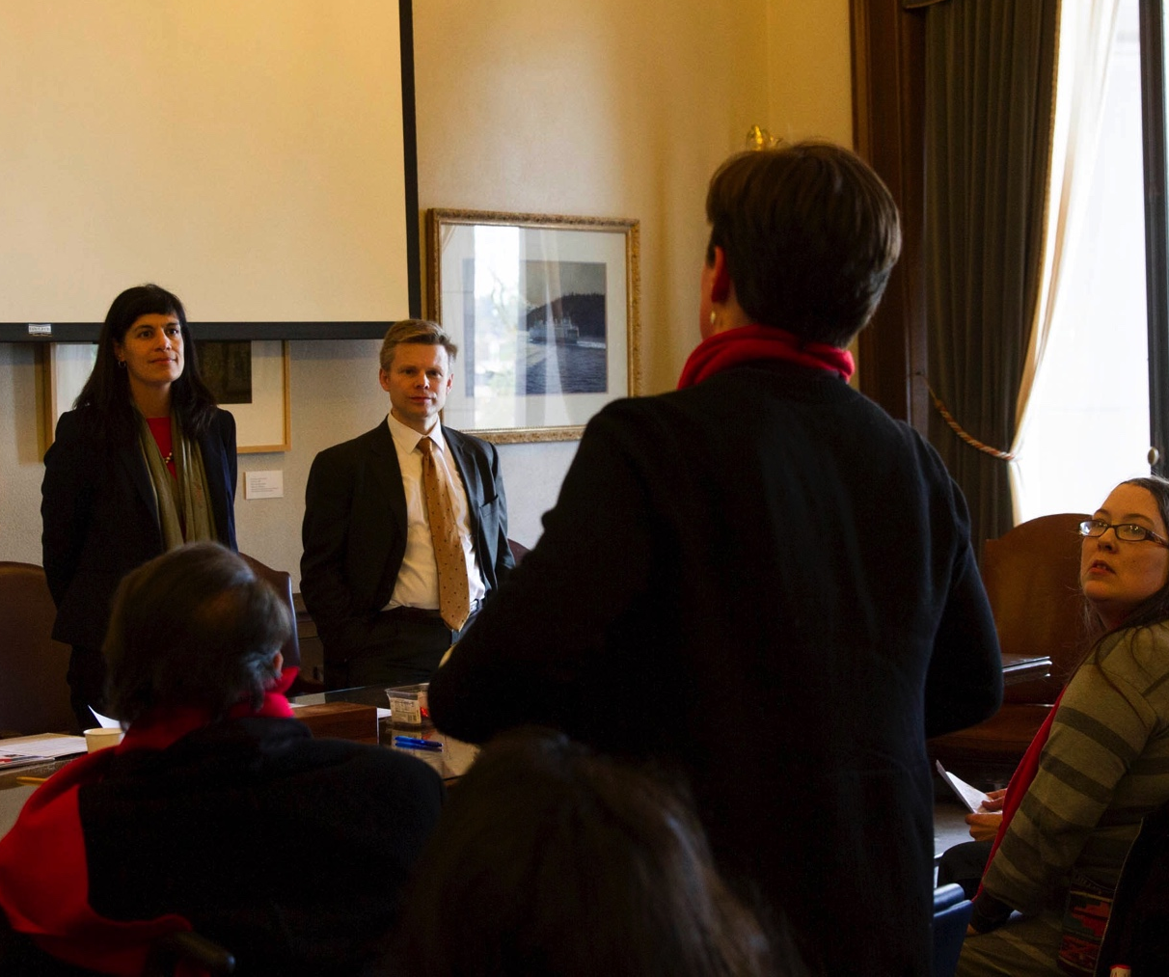
Legislative District Leaders
Building a base of leaders from each of the state’s 49 legislative districts who will build relationships with their lawmakers and mobilize their community to advocate!

Slide 21
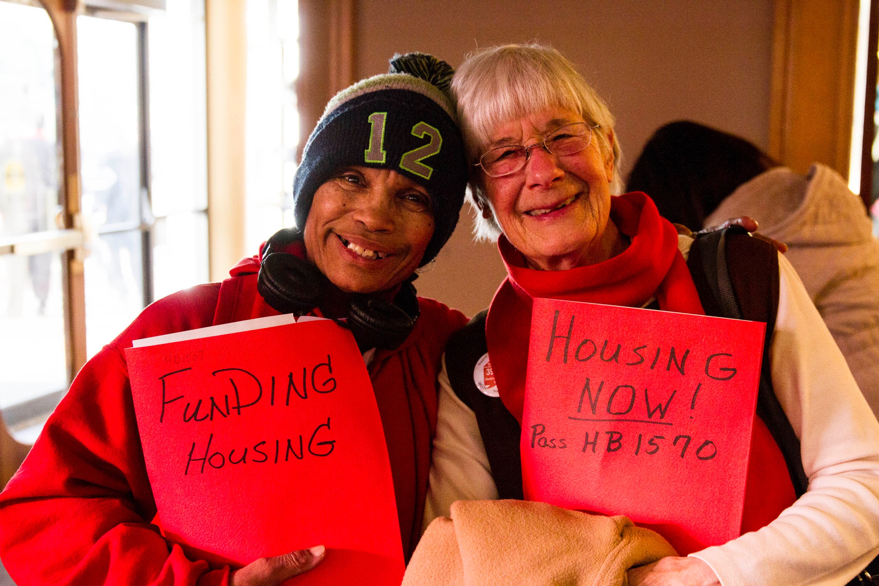
Personal stories are the key to lawmaker education.
Personal stories move lawmakers more than facts alone.
Lawmakers are more likely remember personal stories.
Lawmakers are often compelled to action by personal stories.
Sharing your story to move public policy can be empowering and impactful.

Slide 22
Engaging voters to change the political landscape
Who's in elected office impacts what we can accomplish each legislative session.
Our sister organization, the Action Fund, works to develop and elect housing champions through candidate endorsements, education, and voter turnout.

Slide 23
You are invited! Housing & Homelessness Advocacy Day! January 31st, 2019 in Olympia!

Slide 24
Please contact the Housing Alliance with any questions:
Resident Action Project, Nick Wood: nickw@wliha.org
State Policy Agenda, Michele Thomas: michele@wliha.org
Board Advocacy Project & LD Lead Program, Dimitri Groce: dimitriG@wliha.org
Voter Registration and Housing Alliance Action Fund, Teresa Clark: TeresaC@wliha.org
www.wliha.org I 206-442-9455

